Slide 1
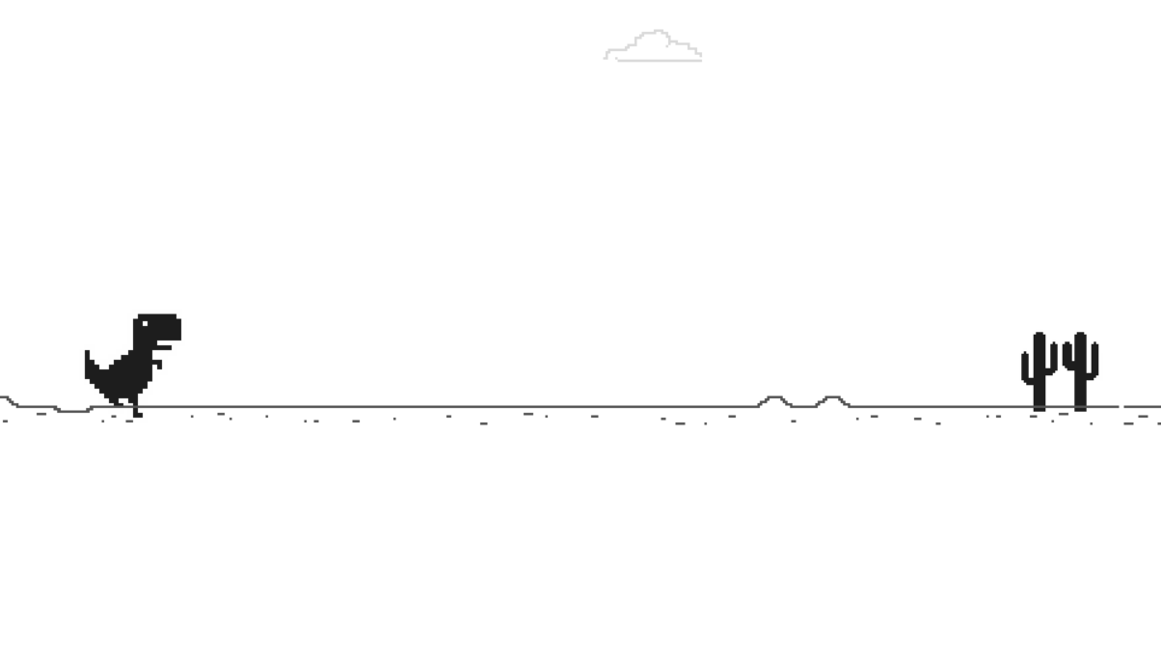
Dino T-Rex

Slide 2

Game Overview
The Dinosaur Game is a simple side-scrolling platformer where player controls a T-Rex. The objective is to navigate the dinosaur through obstacles by jumping and ducking while collecting points.

Slide 3
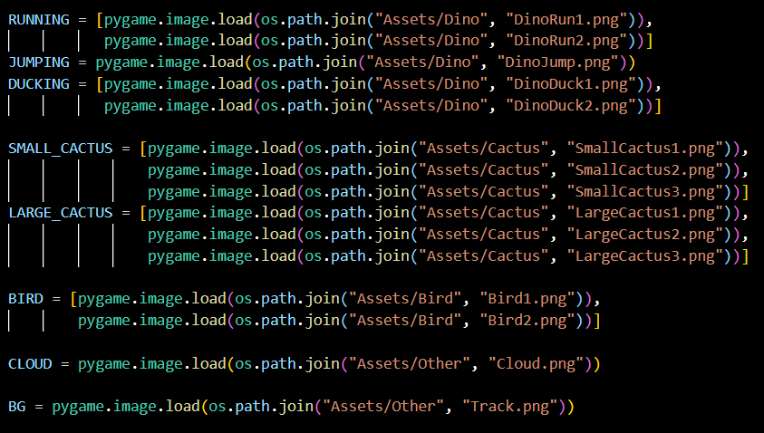








Game Assets
Let's take a look at the assets used in our game, including images for the dinosaur character, obstacles, and background elements.

Slide 4
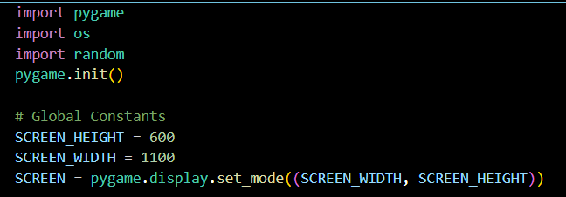
Setup process
Our game is built using the Pygame library, a tool for game development in Python.
We define several global constants to establish the basic parameters of our game environment. These constants include the screen dimensions and the paths to our game assets.

Slide 5
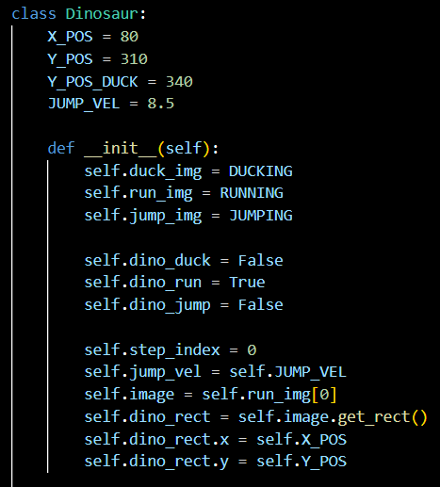
Setting up the T-Rex
The Dinosaur class represents the main character of the game. Its attributes define various parameters related to the dinosaur's position, animation, and behavior. By default, the dinosaur is set to be running and not ducking or jumping.

Slide 6
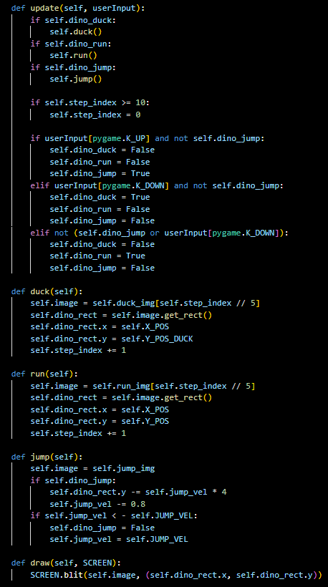
Behaviour of T-Rex
Update Method:
-Updates dinosaur's behavior based on user input.
-Checks if it's ducking, running, or jumping.
-Responds to jump (pygame.K_UP) or duck (pygame.K_DOWN).
Duck, Run and Jump Method:
-Updates image and position when ducking, running and jumping.
-Adjusts bounding box for positions.
-Decreases jump velocity until minimum.

Slide 7
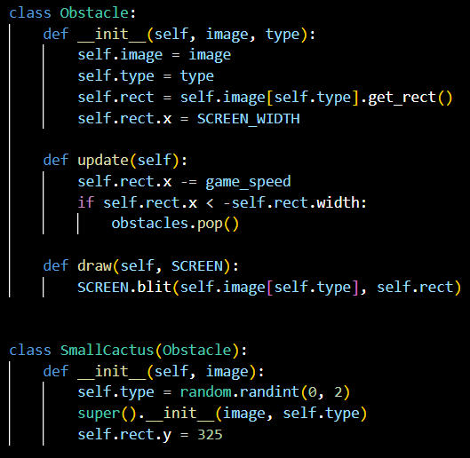
Obstacles
The Obstacle class manages the behavior of obstacles in the game environment. It takes an image list and a type parameter, representing the various obstacle variations and their specific type.
The update method moves the obstacle towards the left of the screen based on the game speed.
The draw method renders the obstacle image onto the screen at its current position.

Slide 8
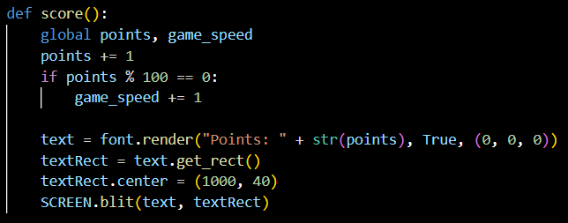
Score
The score() function increments the points variable by one for every frame rendered. If the points reach a multiple of 100, it increases the game speed, adding to the game's difficulty over time.Using the pygame.font.render() function, it creates a text surface displaying the current points.

Slide 9
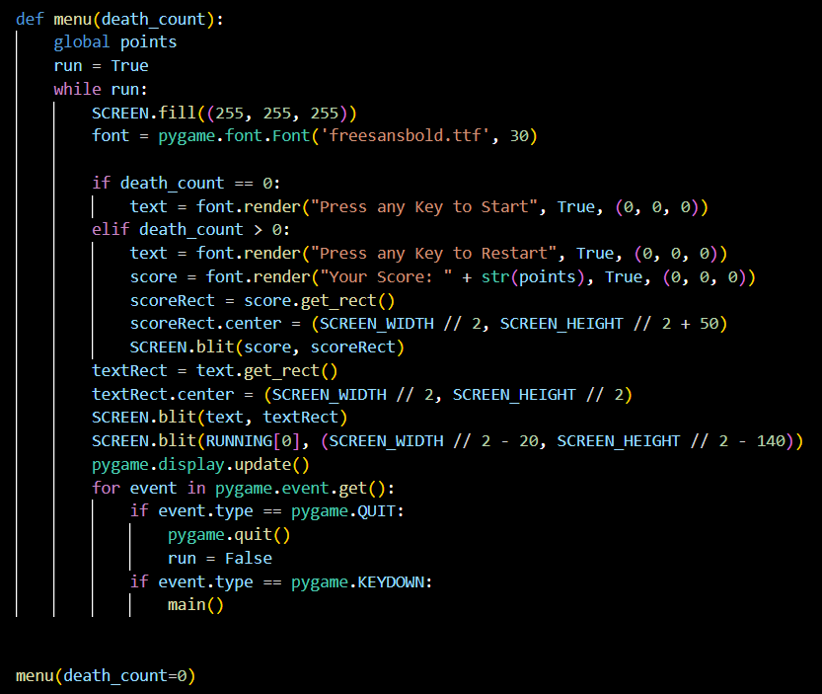
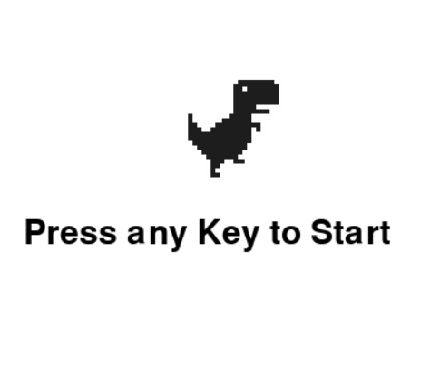
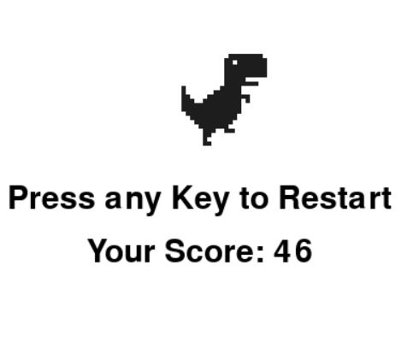
Death and Menu
The `menu()` function manages the game menu, taking `death_count` as input. If `death_count` is 0, it prompts the user to start the game. Otherwise, it prompts to restart along with the player's score. Upon key press, it starts or restarts the game by calling `main()`.

Slide 10
Conclusion
This presentation shows how Pygame makes it easy to create fun 2D games in Python. With things like moving characters, buttons, and keeping track of scores, it’s easier to make games that people enjoy playing. Pygame's simple language and helpful tools make it perfect for anyone who wants to try making games.

Slide 11
Thank you
Presented by
Name | : | Ashraf Uddin Shuvo
ID | : | 0432220005101018
Section | : | 5A1
Name | : | Israt Sultana Tanny
ID | : | 0432220005101016
Section | : | 5A1

